Slide 1

Discrete Distribution
Continuous Distribution
Binomial Distribution
Poisson distribution
Geometric distribution
Uniform Distribution
Exponential distribution
Normal distribution

Slide 2
Binomial Experiment
A binomial experiment has the following properties:
experiment consists of n identical and independent trials
each trial results in one of two outcomes: success or failure
P(success) = p
P(failure) = q = 1 - p for all trials
The random variable of interest, X, is the number of successes in the n trials.
X has a binomial distribution with parameters n and p

Slide 3
EXAMPLES
A coin is flipped 10 times. Success = head.
X = n = p =
Random guessing on a multiple choice exam. 25 questions. 4 answers per question. Success = right answer.
X = n = p =

Slide 4
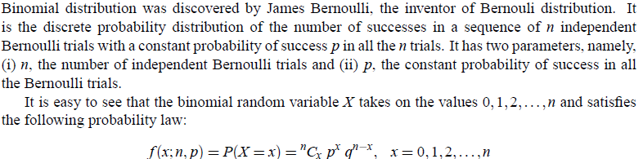
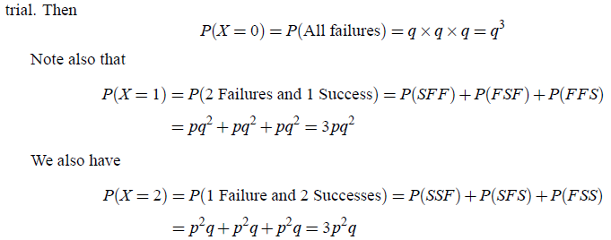

Slide 5
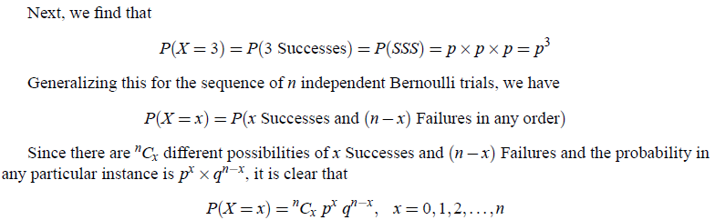
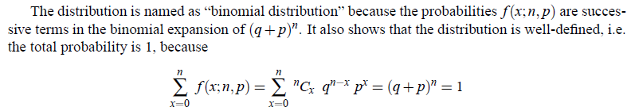
NOTE

Slide 6
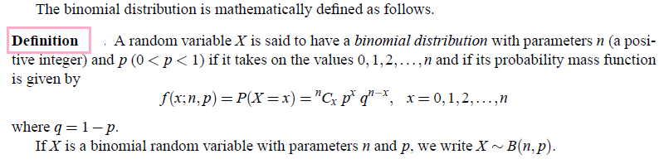
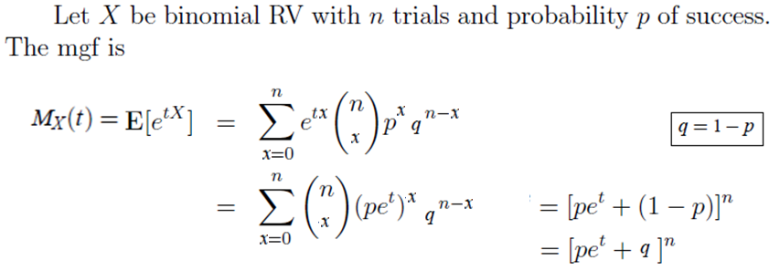

M.G.F , Mean and Variance of Binomial Distribution

Slide 7
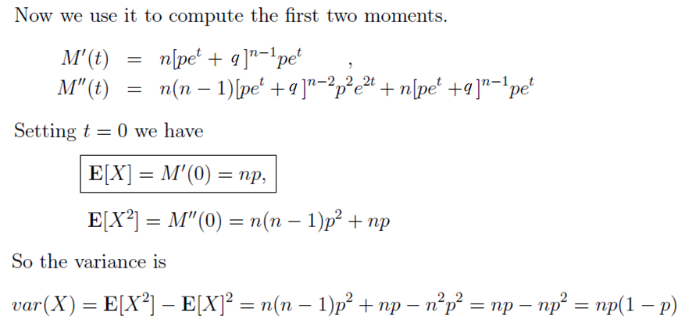
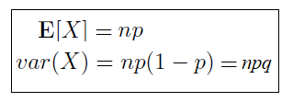

Slide 8

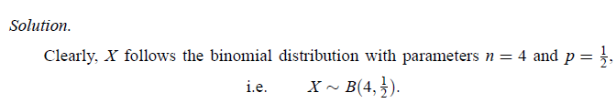
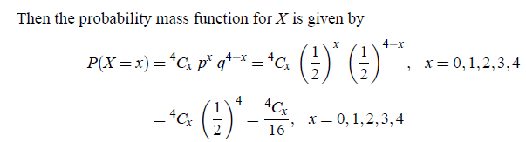
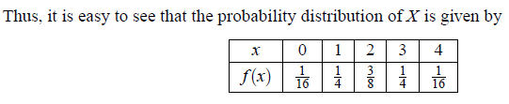
Problem:1

Slide 9

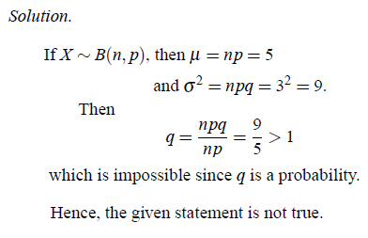
Problem:2

Slide 10
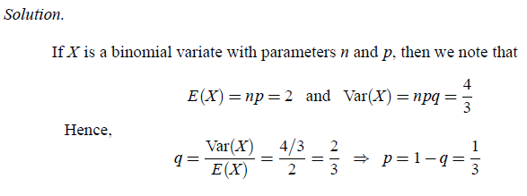
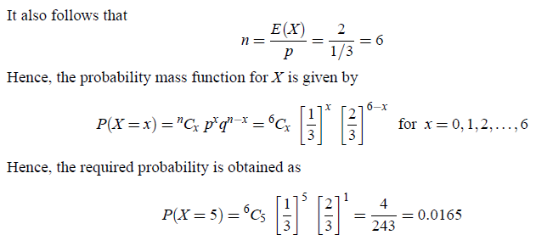
Problem:3

Slide 11

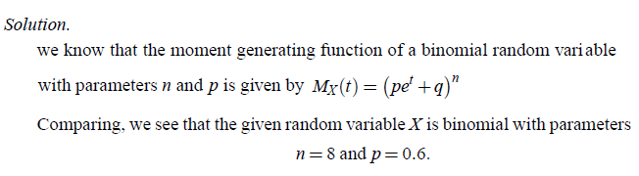

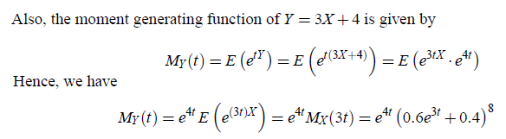
Problem:4

Slide 12

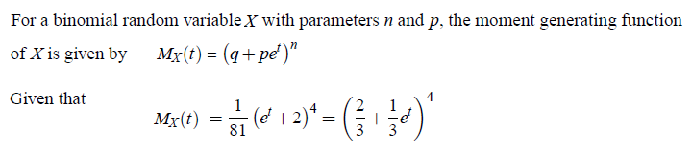
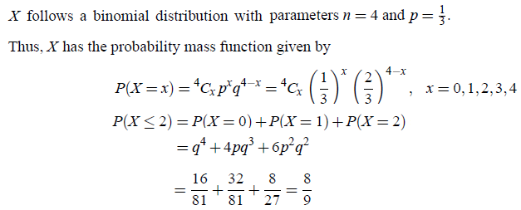
Problem:5

Slide 13

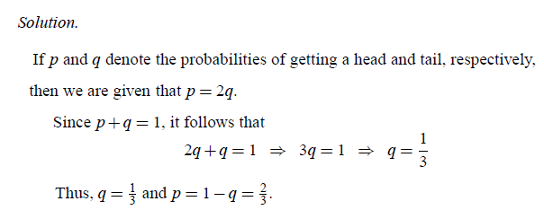
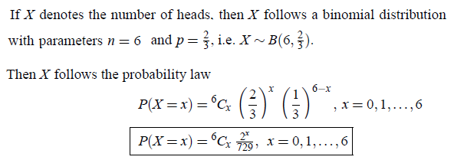
Problem:6

Slide 14
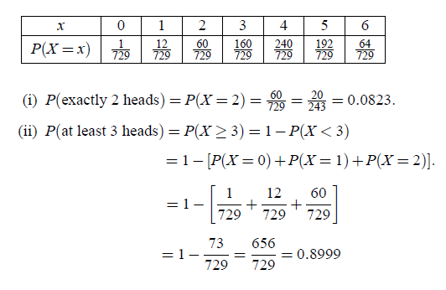


Slide 15

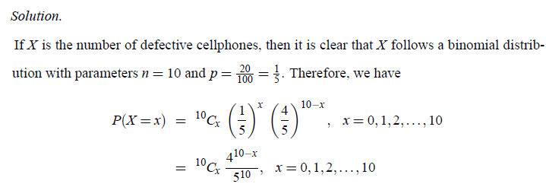
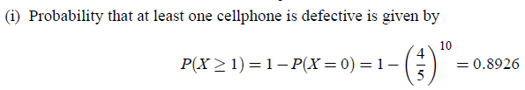
Problem:7

Slide 16
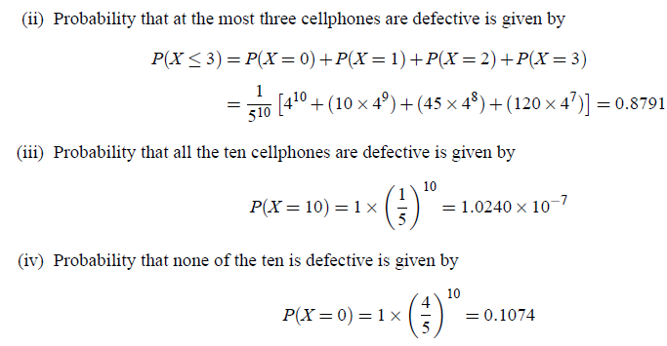

Slide 17

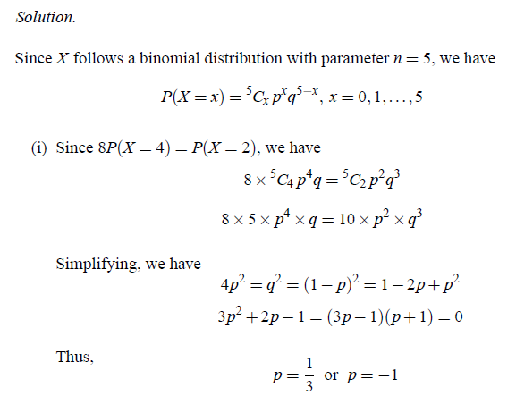
Problem:8

Slide 18
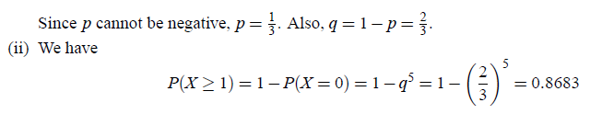
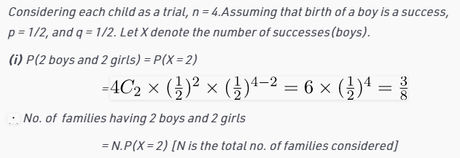

Problem:9
Out of 800 families with 4 children each, how many families would be expected to have
(i) 2 boys and 2 girls (ii) at least one boy (iii) at most 2 girls (iv) children of both gender. Assume equal probability for boys and girls.

Slide 19
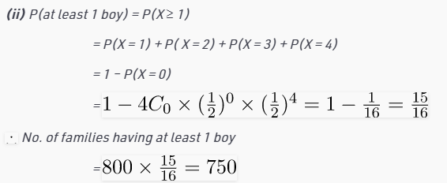
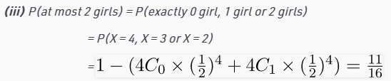

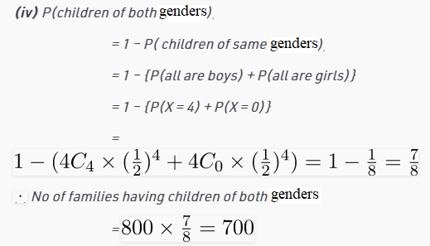

Slide 20
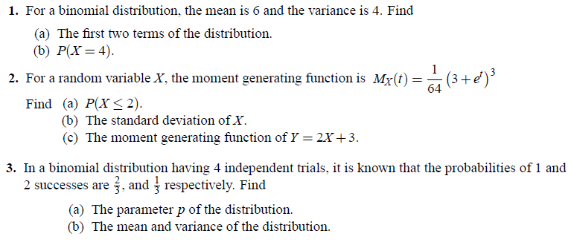
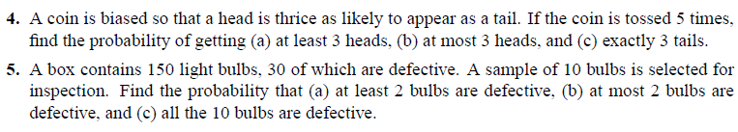
Problems for Practice

